Slide 1
Chapter 2: Intro to Relational Model

Slide 2
Outline
Structure of Relational Databases
Database Schema
Keys
Schema Diagrams
Relational Query Languages
The Relational Algebra
Notes:
1

Slide 3
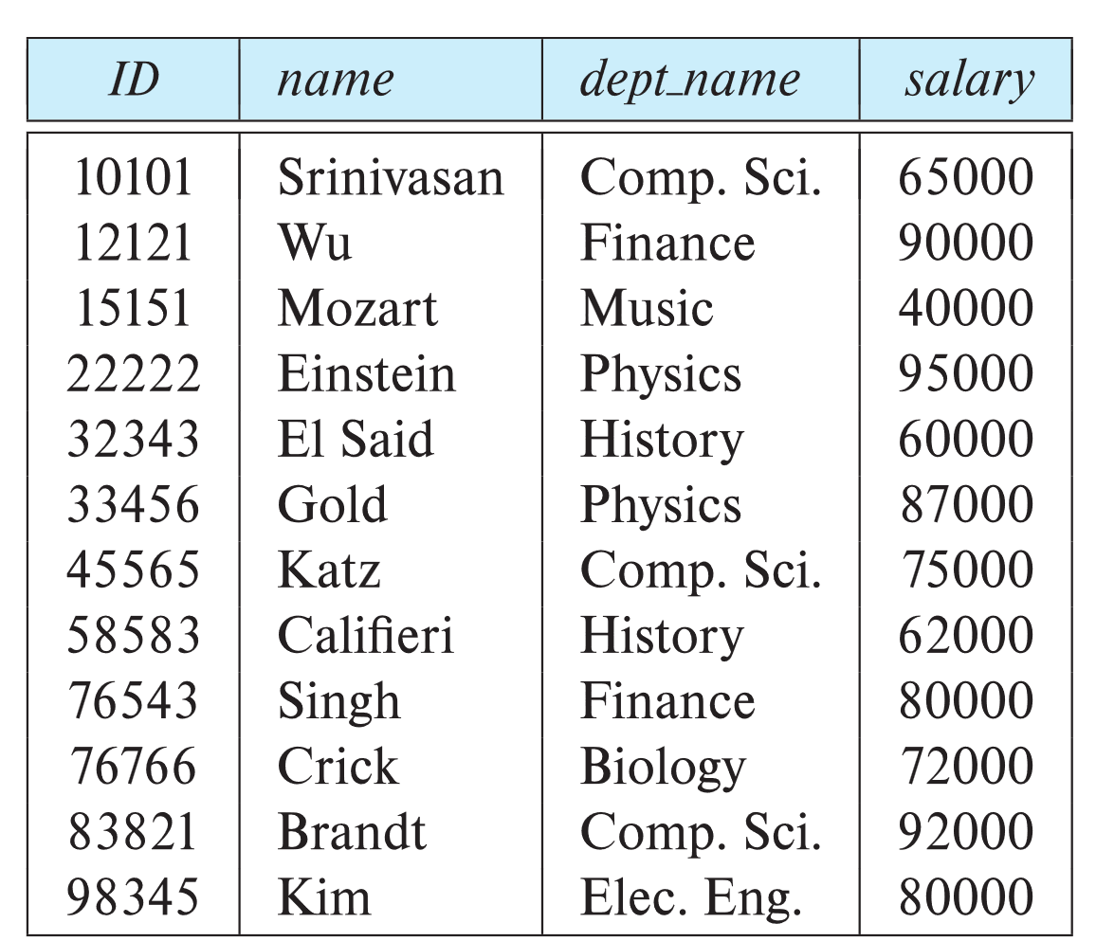
Example of an Instructor Relation
attributes
(or columns)
tuples
(or rows)

Slide 4
Relation Schema and Instance
A₁, A₂, …, A_{n} are attributes
R = (A₁, A₂, …, A_{n} ) is a relation schema
Example:
instructor = (ID, name, dept_name, salary)
A relation instance r defined over schema R is denoted by r (R).
The current values a relation are specified by a table
An element t of relation r is called a tuple and is represented by a row in a table
Notes:
1

Slide 5
Attributes
The set of allowed values for each attribute is called the domain of the attribute
The special value null is a member of every domain. Indicates that the value is “unknown”
The null value causes complications in the definition of many operations

Slide 6
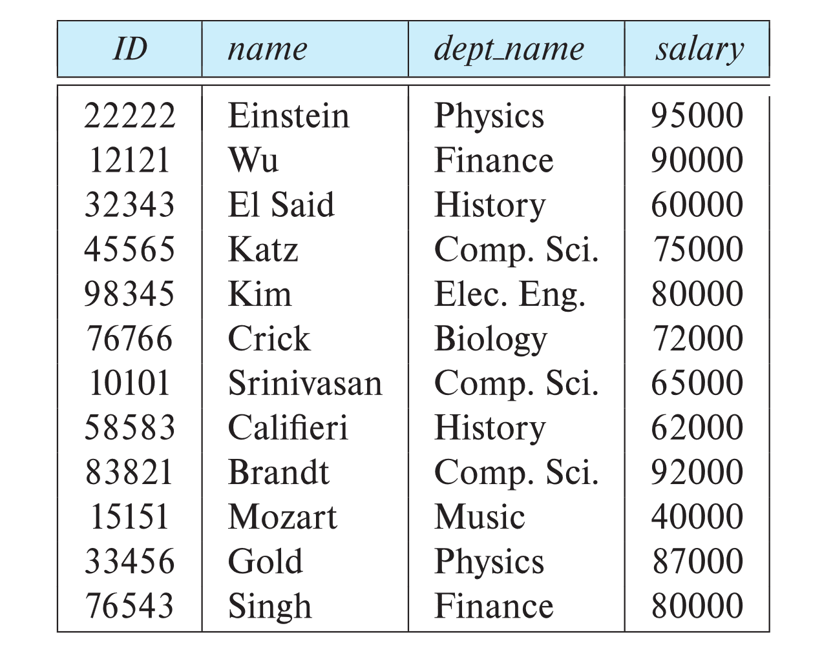
Relations are Unordered
Order of tuples is irrelevant (tuples may be stored in an arbitrary order)
Example: instructor relation with unordered tuples

Slide 7
Database Schema
Database schema -- is the logical structure of the database.
Database instance -- is a snapshot of the data in the database at a given instant in time.
Example:
schema: instructor (ID, name, dept_name, salary)
Instance:

Slide 8
Keys
Let K ⊆ R
K is a superkey of R if values for K are sufficient to identify a unique tuple of each possible relation r(R)
Example: {ID} and {ID, name} are both superkeys of instructor.
How do you know K is a superkey?
Superkey K is a candidate key if K is minimal
Example: {ID} is a candidate key for Instructor
One of the candidate keys is selected to be the primary key.
Which one?

Slide 9
Foreign Key
Foreign key constraint: Value in one relation must appear in another
Referencing relation
Referenced relation
Example:
dept_name in the instructor table is a foreign key from instructor table referencing department table
If Einstein (in Physics) appears in in the instructor table, then department table must include Physics.
What happens to Einstein if the Physics department is dissolved?

Slide 10
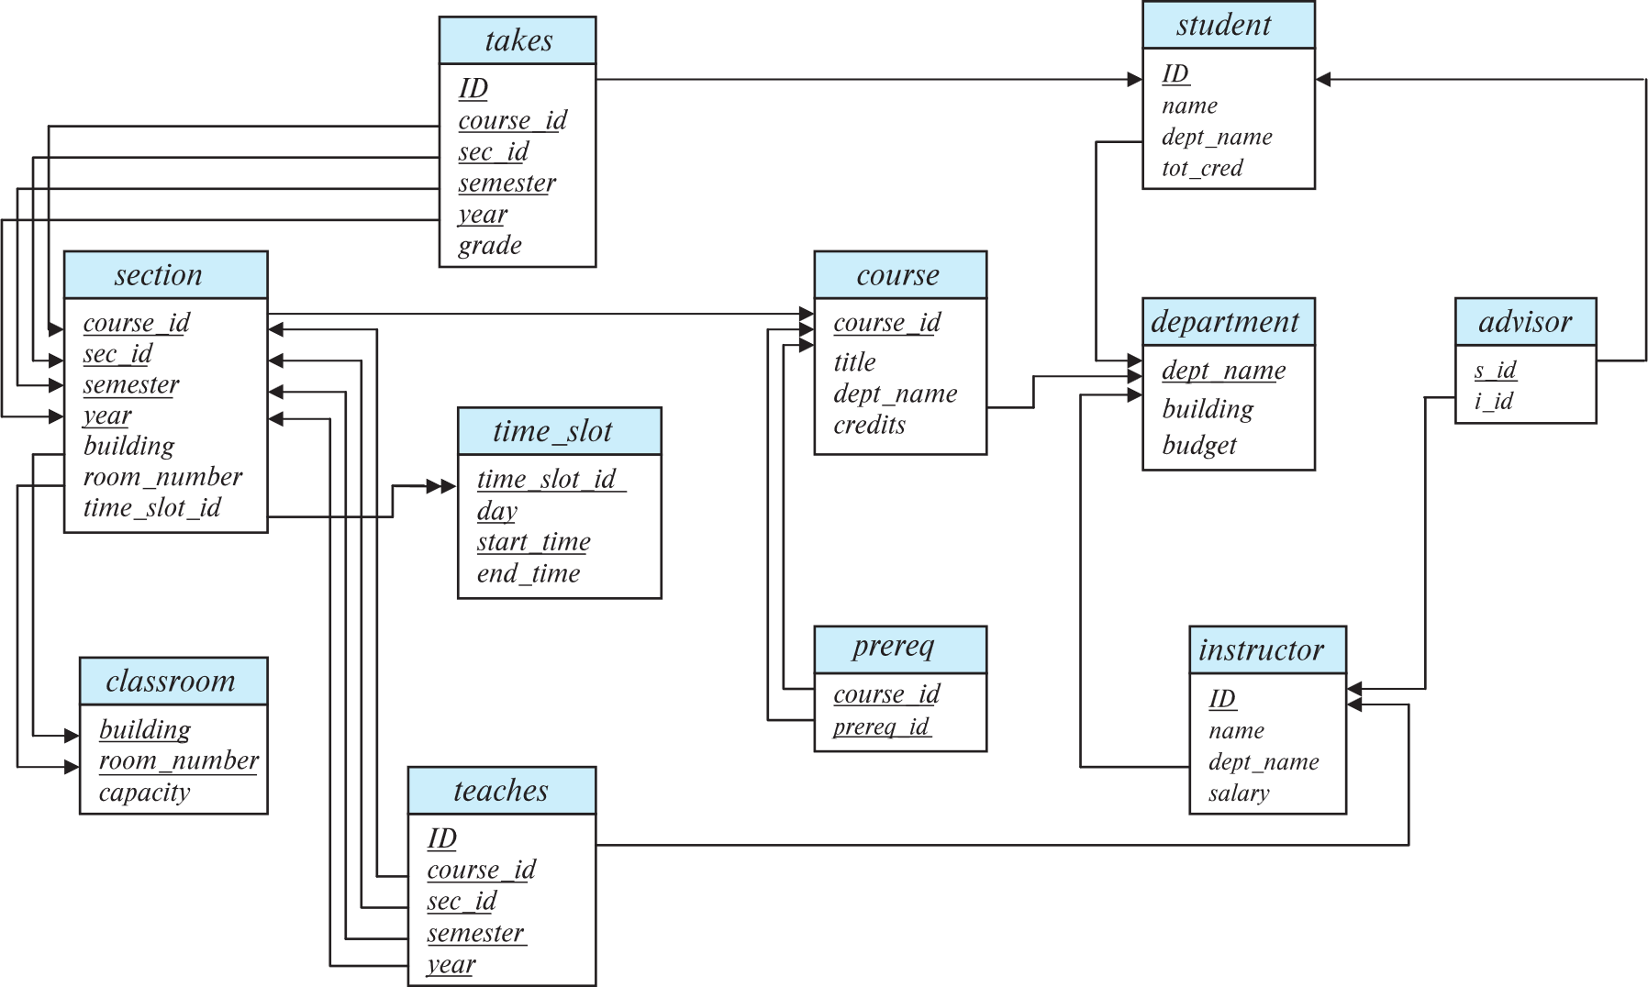
Schema Diagram for University Database

Slide 11
Pure Relational Query Languages
“Pure” languages:
Relational algebra
Tuple relational calculus
Domain relational calculus
The above 3 pure languages are equivalent in computing power
We will concentrate in this chapter on relational algebra
Not Turing-machine equivalent
Consists of 6 basic operations

Slide 12
Relational Algebra
Consists of a set of operations that take several relations as input and produce a new relation as their result.
Six basic operators
select: σ (sigma)
project: ∏ (Pi)
Cartesian product: x
union: ∪
set difference: –
rename: ρ (rho)

Slide 13
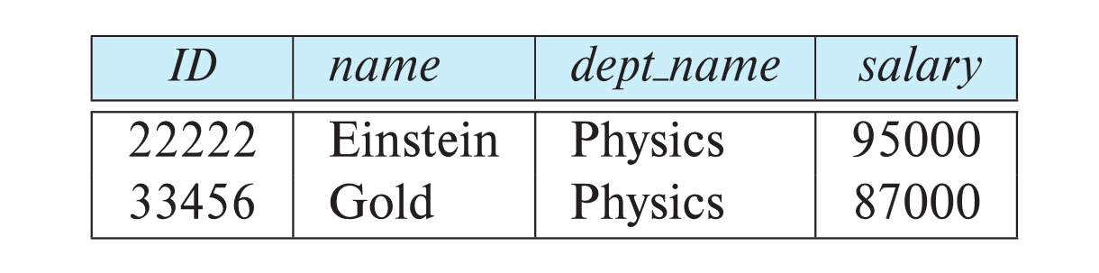
Select Operation
The select operation selects tuples that satisfy a given predicate.
Notation: σ _{p} (r)
p is called the selection predicate
Example: select those tuples of the instructor relation where the instructor is in the “Physics” department.
Query
σ _{dept_name =“Physics”} (instructor)
Result

Slide 14
Select Operation (Cont.)
We allow comparisons using
=, ≠, >, ≥. <. ≤
in the selection predicate.
We can combine several predicates into a larger predicate by using the connectives:
∧ (and), ∨ (or), ¬ (not)
Example: Find the instructors in Physics with a salary greater $90,000, we write:
σ _{dept_name =“Physics”} ∧ _{salary >} _{90,000} (instructor)
The select predicate may include comparisons between two attributes.
Example, find all departments whose name is the same as their building name:
σ _{dept_name = building} (department)

Slide 15
Project Operation
A unary operation that returns its argument relation, with certain attributes left out.
Notation:
∏ _{A1,A2,A3 ….Ak} (r)
where A₁, A₂, …, A_{k} are attribute names and r is a relation name.
The result is defined as the relation of k columns obtained by erasing the columns that are not listed
Duplicate rows removed from result, since relations are sets

Slide 16
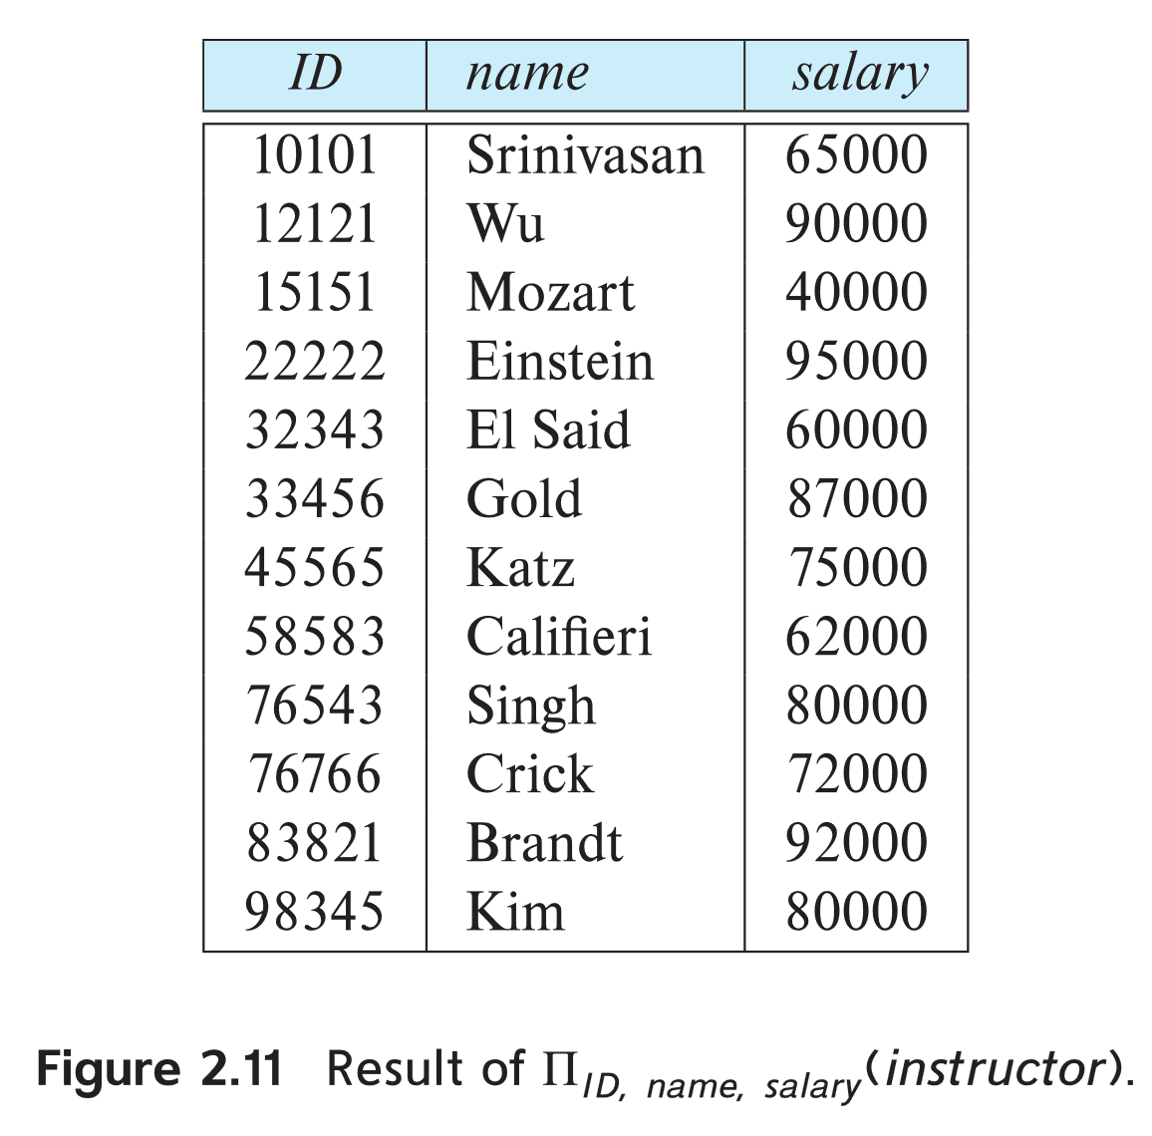
Project Operation Example
Example: eliminate the dept_name attribute of instructor
Query: ∏_{ID, name, salary} (instructor)
Result:

Slide 17
Composition of Relational Operations
The result of a relational-algebra operation is a relation and therefore relational-algebra operations can be composed together into a relational-algebra expression.
Consider the query -- Find the names of all instructors in the Physics department.
∏_{name}(σ _{dept_name} _{=“Physics”} (instructor))
Instead of giving the name of a relation as the argument of the projection operation, we give an expression that evaluates to a relation.

Slide 18
Cartesian-Product Operation
The Cartesian-product operation (denoted by X) allows us to combine information from any two relations.
Example: the Cartesian product of the relations instructor and teaches is written as:
instructor X teaches
We construct a tuple of the result out of each possible pair of tuples:
One from the instructor relation, and
One from the teaches relation
Since the instructor ID appears in both relations, we distinguish between these two attribute by attaching to the attribute the name of the relation from which the attribute originally came.
instructor.ID
teaches.ID

Slide 19
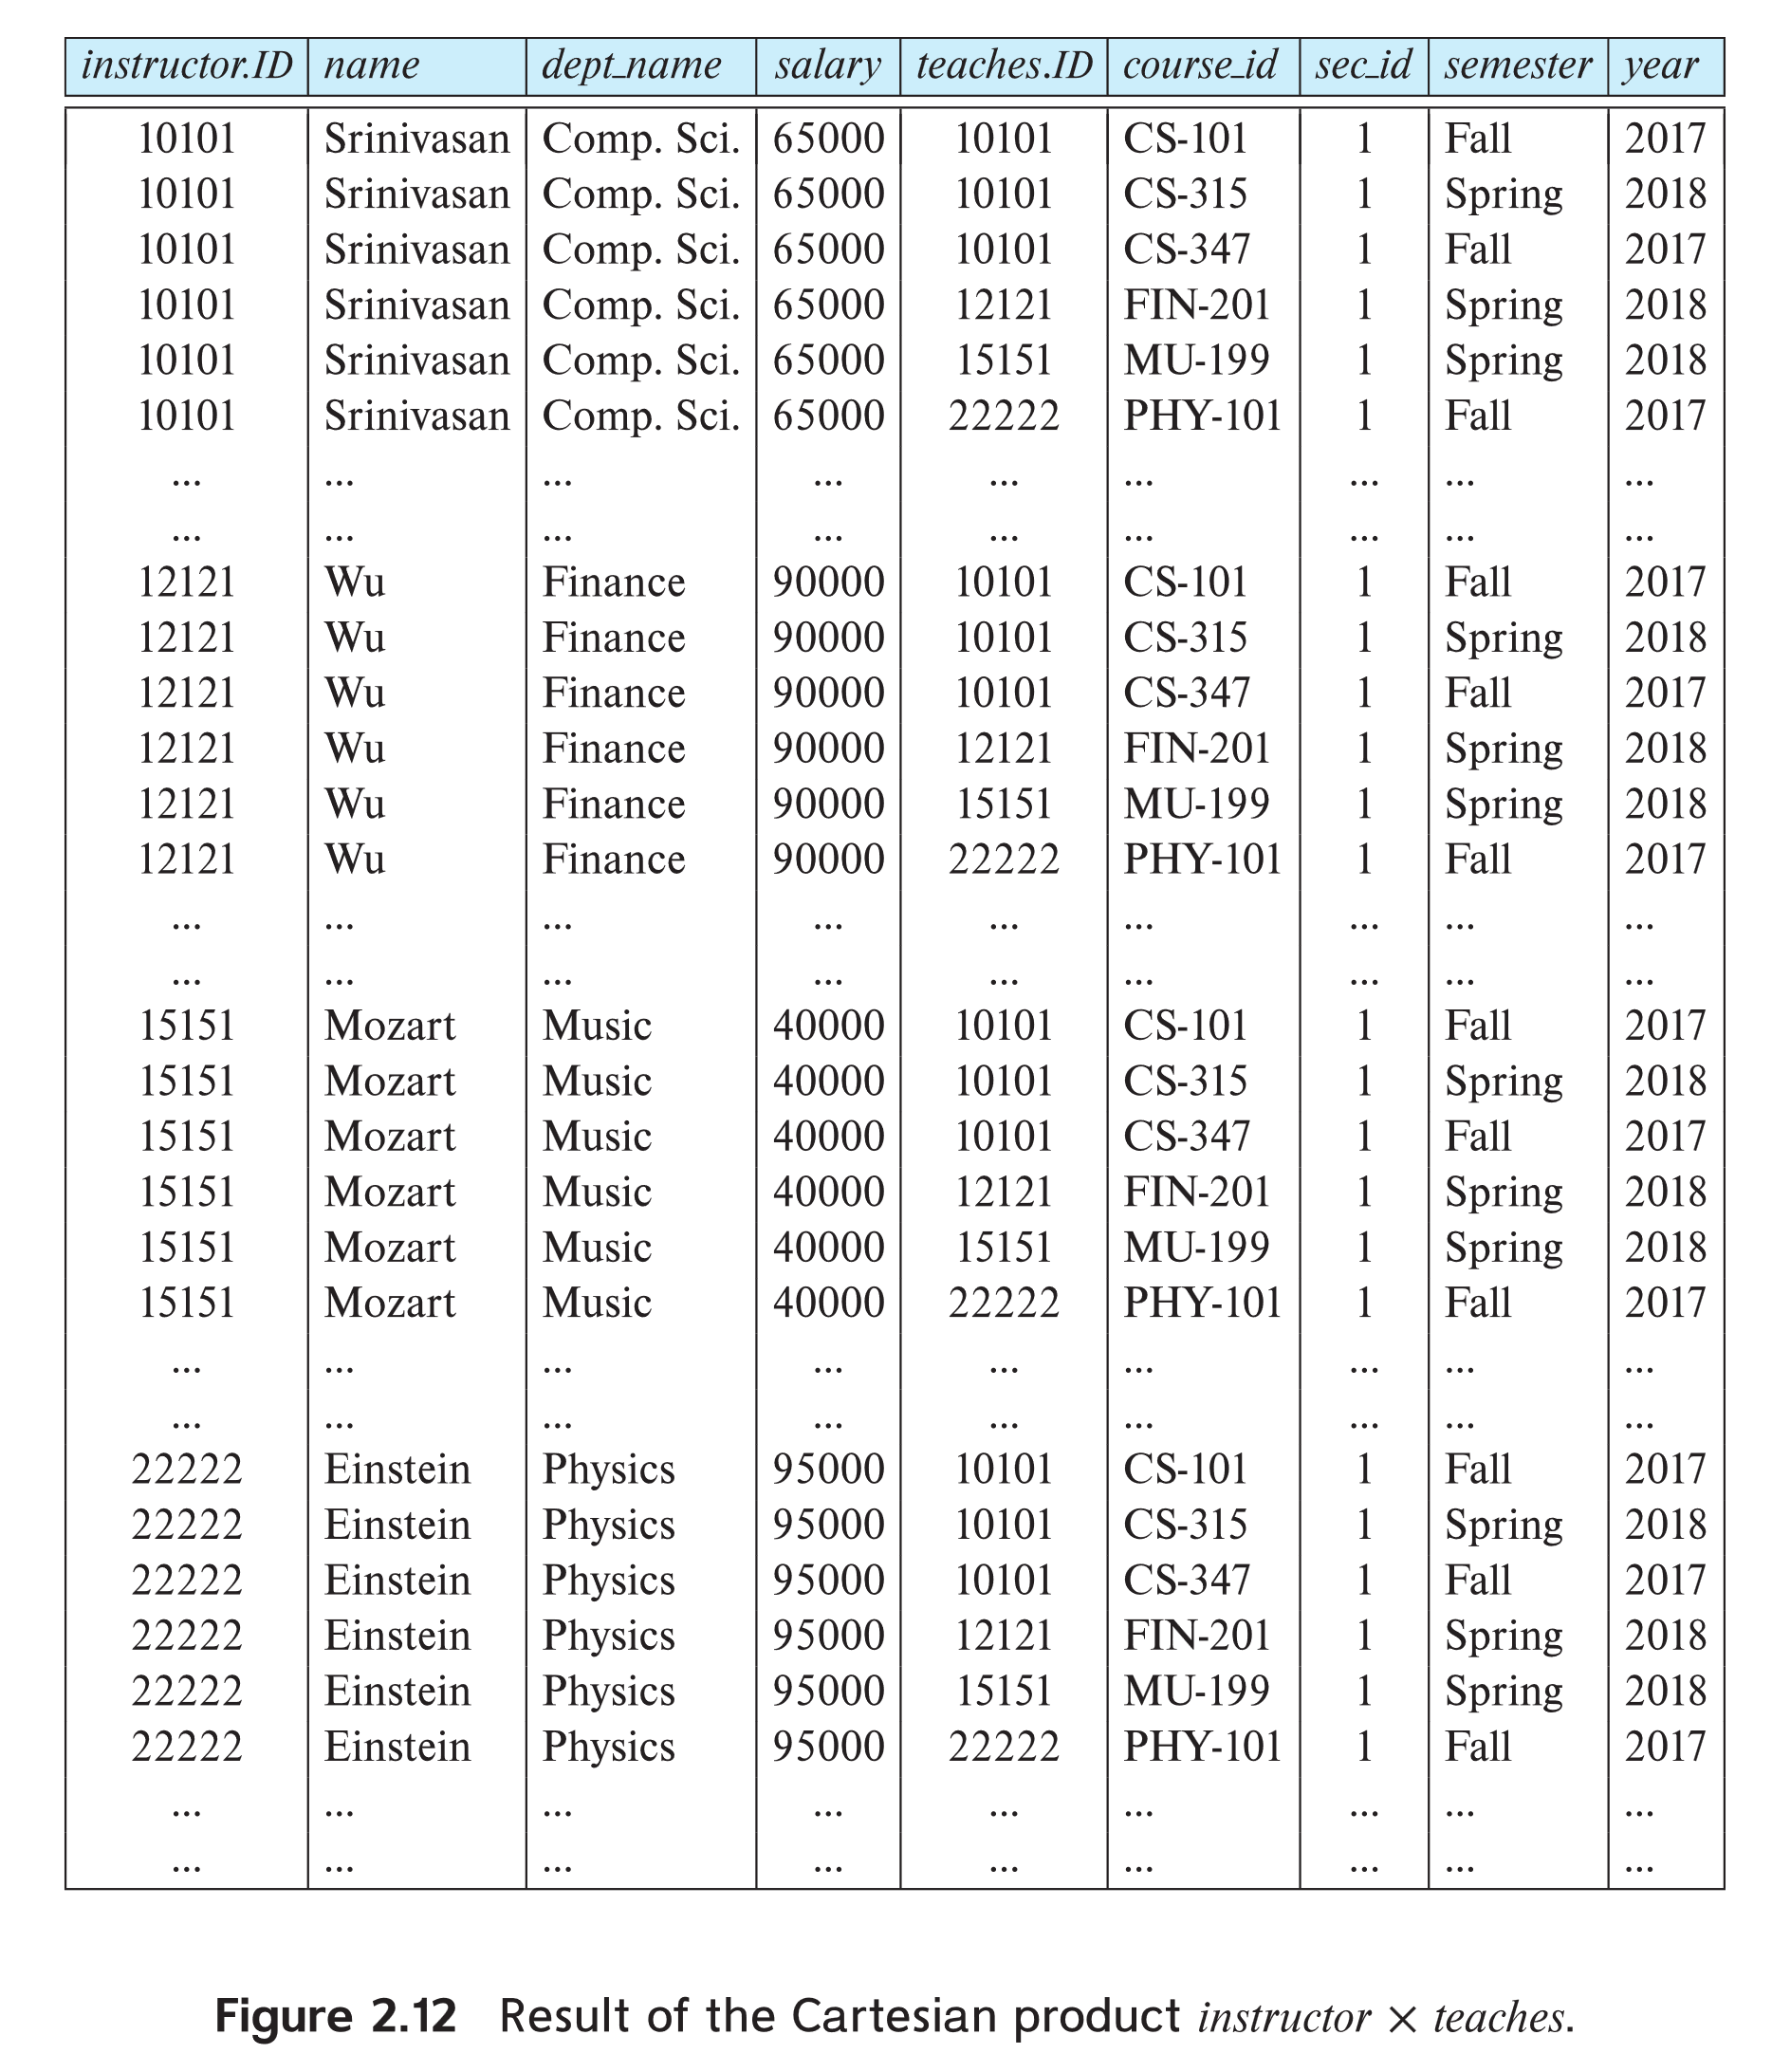
The instructor X teaches table

Slide 20
Join Scheme
The Cartesian-Product
instructor X teaches
associates every tuple of instructor with every tuple of teaches.
Most of the resulting rows have information about instructors who did NOT teach a particular course.
To get only those tuples of “instructor X teaches “ that pertain to instructors and the courses that they taught, we write:
σ _{instructor.id = teaches.id} (instructor x teaches )
We get only those tuples of “instructor X teaches” that pertain to instructors and the courses that they taught.
The result of this expression, shown in the next slide
This leads us to the introduction of a new operation -- theta join

Slide 21
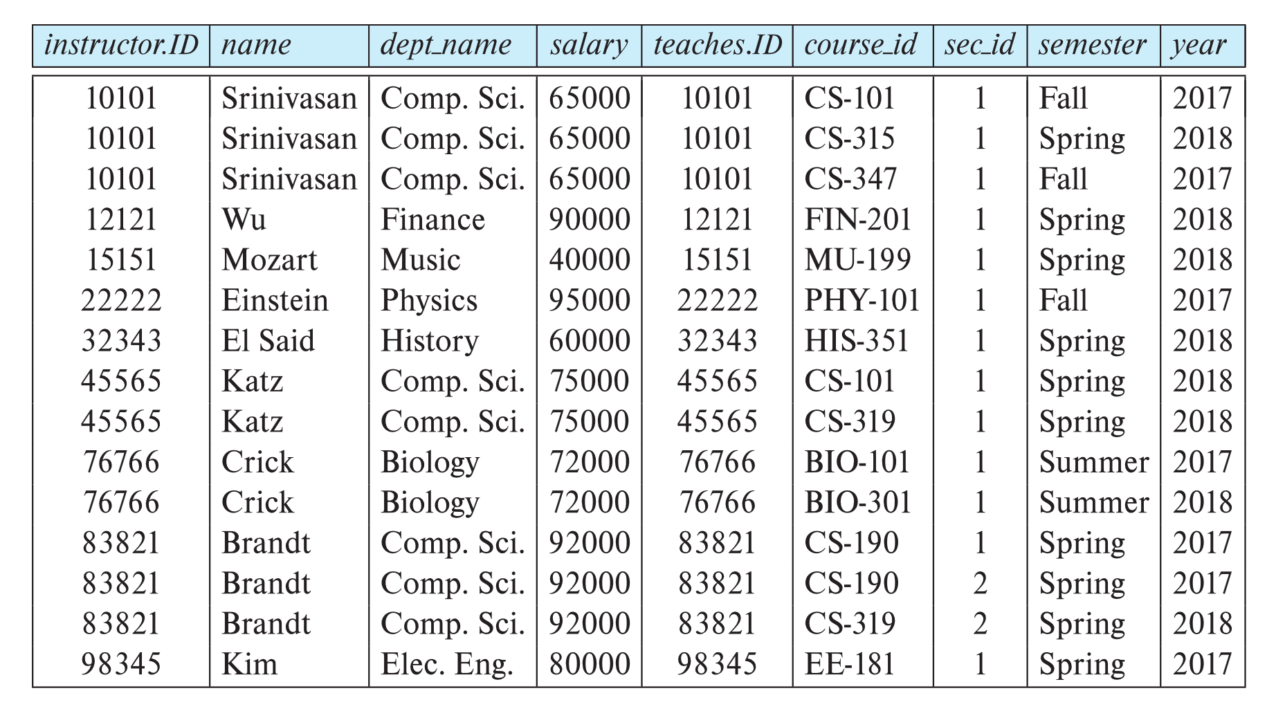
Join Scheme (Cont.)
The table corresponding to:
σ _{instructor.id = teaches.id} (instructor x teaches)

Slide 22
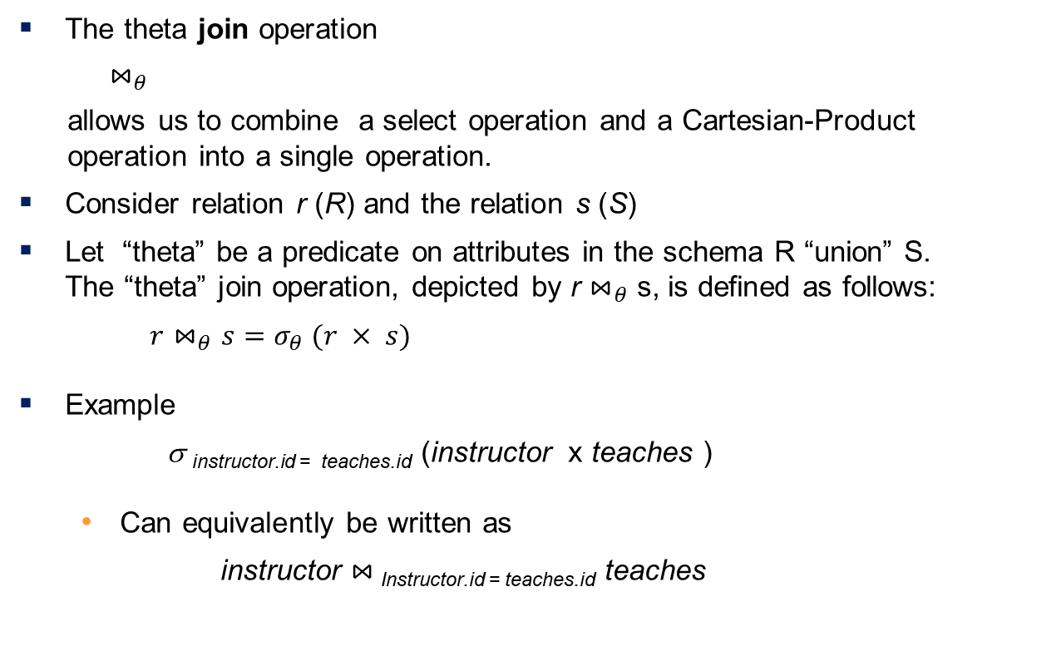
Theta Join Operation
The theta join operation
$⋈_{θ}$
allows us to combine a select operation and a Cartesian-Product
operation into a single operation.
Consider relation r (R) and the relation s (S)
Let “theta” be a predicate on attributes in the schema R “union” S. The “theta” join operation, depicted by r $⋈_{θ}$ s, is defined as follows:
$r⋈_{θ}s=σ_{θ} (r × s)$
Example
σ _{instructor.id = teaches.id} (instructor x teaches )
Can equivalently be written as
instructor $⋈_{ }$_{Instructor.id = teaches.id} teaches

Slide 23

Natural Join Operation
The natural join operation
$⋈$
replaces the predicate theta in $⋈_{θ}$ with an implicit predicate that
requires equality over those attributes that appear in the schemas
of both the left and right relations.
This is notationally convenient but poses risks for queries where attributes with same name match but should not. More in Chapter 3.

Slide 24
Union Operation
The union operation allows us to combine two relations
Notation: r ∪ s
For r ∪ s to be valid.
1. r, s must have the same arity (same number of attributes)
2. The attribute domains must be compatible (example: 2nd
column of r deals with the same type of values as does the
2nd column of s)
Example: to find all courses taught in the Fall 2017 semester, or in the Spring 2018 semester, or in both semester ∏_{course_id} (σ _{semester=“Fall” Λ year=2017} (section)) ∪ ∏_{course_id} (σ _{semester=“Spring” Λ year=2018} (section))

Slide 25
Set-Intersection Operation
The set-intersection operation allows us to find tuples that are in both the input relations.
Notation: r ∩ s
Assume:
r, s have the same arity
Attributes of r and s are compatible
Example: Find the set of all courses taught in both the Fall 2017 and the Spring 2018 semesters.
∏_{course_id} (σ _{semester=“Fall” Λ year=2017} (section)) ∩ ∏_{course_id} (σ _{semester=“Spring” Λ year=2018} (section))

Slide 26
Set Difference Operation
The set-difference operation allows us to find tuples that are in one relation but are not in another.
Notation r – s
Set differences must be taken between compatible relations.
r and s must have the same arity
Attribute of r and s must be compatible
Example: to find all courses taught in the Fall 2017 semester, but not in the Spring 2018 semester ∏_{course_id} (σ _{semester=“Fall” Λ year=2017} (section)) − ∏_{course_id} (σ _{semester=“Spring” Λ year=2018} (section))

Slide 27
Do we need the Set-intersection operation?

Slide 28
The Rename Operation
The results of relational-algebra expressions do not have a name that we can use to refer to them. The rename operator, ρ , is provided for that purpose
The expression:
ρ_{x} (E)
returns the result of expression E under the name x
Another form of the rename operation:
ρ_{x(A1,A2, .. An)} (E)

Slide 29
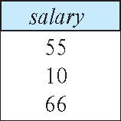
The Rename Operation Use Example
Suppose you have a table salary consisting the salaries of all instructors in a university.
Suppose that we want to take the Cartesian product salary x salary
We need rename one of the “salary” tables
The expression:
salary x ρ _{s1} (salary)
gives us a schema:
salary, s1

Slide 30
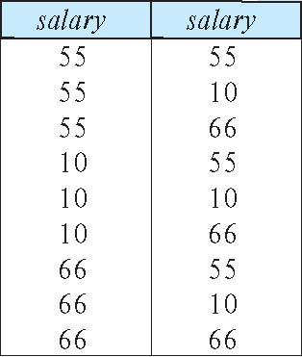
Finding Largest Salary
We need to first compute
salary x ρ _{s1} (salary)
Result
s1

Slide 31
Finding Largest Salary (Cont.)
X
Find all the salaries that are less than the largest salary
Y
Find all the salaries
Finding the largest salary
Y – X
Homework. Write:
X
Y
Y – X
In a single RA expression
Notes:
9

Slide 32
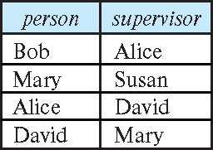
Another Rename Operation Use Example
Consider the relation Boss
Find the manger of Bob
∏_{supervisor}(σ _{person} _{=“ Bob”} (Boss))

Slide 33
The Rename Operation Example (Cont.)
To find the second-level manger of Bob
we take the Cartesian product of the relation Boss and Boss
The expression:
Boss x ρ _{BB} (Boss)
gives us a schema: person, supervisor, BB.person, BB,supervisor
The expression
∏_{BB.supervisor}(σ _{person} _{=“Bob”} ∧ _{supervisor = BB.petson} (Boss x ρ _{BB} (Boss)))
gives us the second-level manger of Bob

Slide 34
The Assignment Operation
It is convenient at times to write a relational-algebra expression by assigning parts of it to temporary relation variables.
The assignment operation is denoted by
←
and works like assignment in a programming language.
Example: Find all instructor in the “Physics” and Music department. Physics ← σ _{dept_name=“Physics”} (instructor)
Music ← σ _{dept_name=“Music”} (instructor)
Physics ∪ Music
With the assignment operation, a query can be written as a sequential program consisting of a series of assignments followed by an expression whose value is displayed as the result of the query.

Slide 35
Equivalent Queries
There is more than one way to write a query in relational algebra.
Example: Find information about courses taught by instructors in the Physics department with salary greater than 90,000
Query 1
σ _{dept_name=“Physics”} ∧ _{salary > 90,000} (instructor)
Query 2
σ _{dept_name=“Physics”} (σ _{salary > 90.000} (instructor))
The two queries are not identical; they are, however, equivalent
They give the same result on any database.
Which one is better?

Slide 36
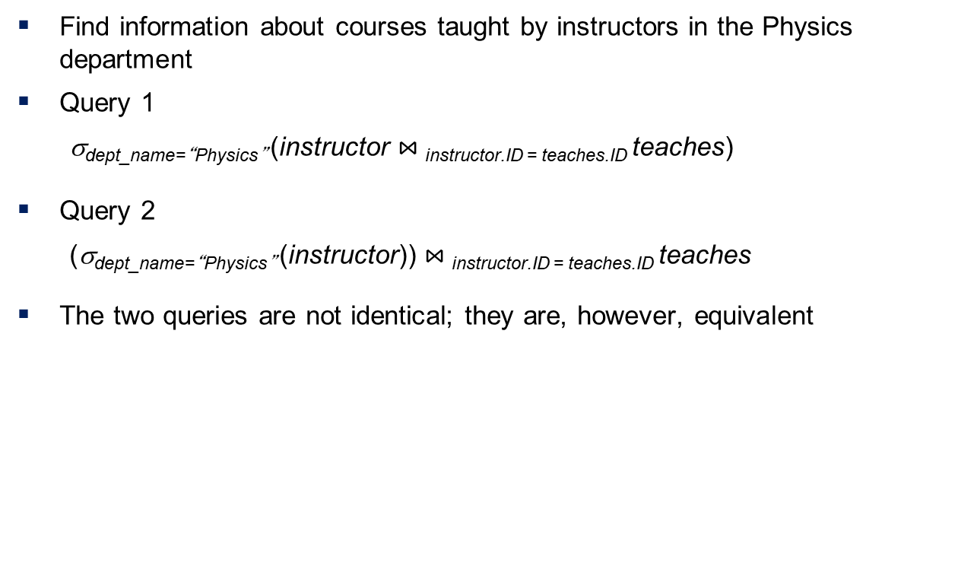
Equivalent Queries – Another Example
Find information about courses taught by instructors in the Physics department
Query 1
σ_{dept_name=“Physics”} (instructor $⋈_{ }$_{instructor.ID = teaches.ID} teaches)
Query 2
(σ_{dept_name=“Physics”} (instructor)) $⋈_{ }$_{instructor.ID = teaches.ID} teaches
The two queries are not identical; they are, however, equivalent

Slide 37
Food for Thought
Consider the relation Boss, with an instance
Write a rational algebra expression to:
1. Find the supervisor of “Bob”
2. Find the supervisor of the supervisor of “Bob”
3. Find ALL the supervisors (direct and indirect) of “Bob”?
Notes:
9

Slide 38
Food for Thought (Cont.)
How would you prove that relational algebra is not Turing-machine equivalent. That is, there are queries that cannot be expressed in relational algebra?
Why was it decided that relational algebra be a language that is not Turing-machine equivalent?
Notes:
9

Slide 39
End of Chapter 2

Slide 40
The Rename Operation Use Example
Suppose you have a table salary consisting the salaries of all instructors in a university.
How do we find out the largest salary?
Take the Cartesian product of salary and salary
See next slide

